Slide 1

UNIVERSITY INSTITUTE OF ENGINEERING
COMPUTER SCIENCE ENGINEERING
AI
(23CSH-621)
INTRODUCTION
DISCOVER . LEARN . EMPOWER

Slide 2
INTRODUCTION
Biological nervous system is the most important part of many living things, in particular, human beings.
There is a part called brain at the center of human nervous system.
In fact, any biological nervous system consists of a large number of interconnected processing units called neurons.
Each neuron is approximately 10µm long and they can operate in parallel.
Typically, a human brain consists of approximately 10¹¹ neurons communicating with each other with the help of electrical impulses.

Slide 3
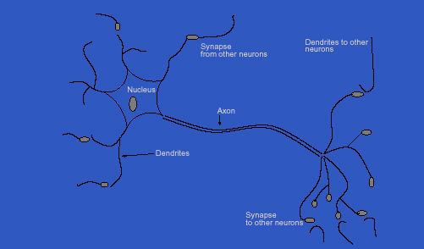
Human brain inspiration:
Biological neuron

Slide 4
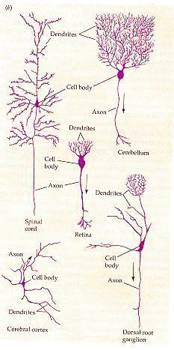
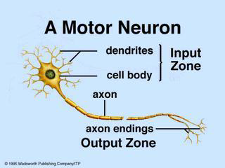
Biological Neural Network
A biological neuron has three types of main components; dendrites, soma(or cell body) and axon.
Dendrites receives signals from other neurons.
The soma, sums the incoming signals. When sufficient input is received , the cell fires; that is it transmit a signal over its axon to other cells.

Slide 5
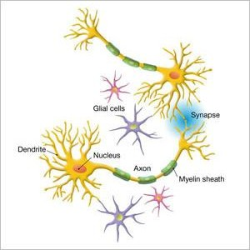
Neuron and its working

Slide 6
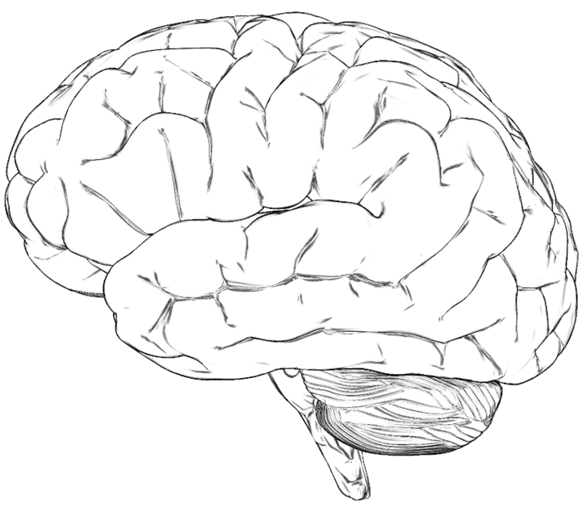
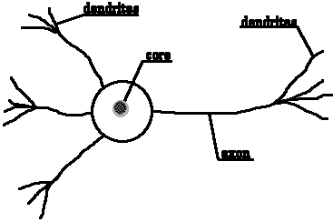
Neuron: Basic unit of nervous system
Dendrite of another neuron
Synapse
soma
Neuron: Biological
Neuron: Artificial

Slide 7
Neuron and its working
Dendrite of another neuron
Synapse
soma
Figure shows a schematic of a biological neuron. There are different parts in it : dendrite, soma, axon and synapse.
Dendrite : A bush of very thin fibre.
Axon : A long cylindrical fibre.
Soma : It is also called a cell body, and just like as a nucleus of cell.
Synapse : It is a junction where axon makes contact with the dendrites of neighboring dendrites.

Slide 8
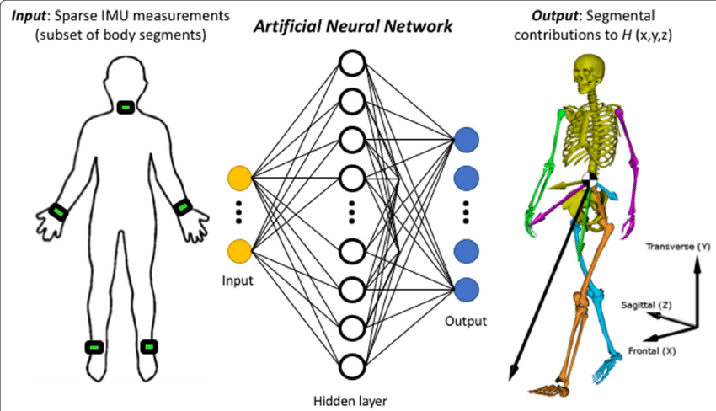
The idea of ANN?
NNs learn relationship between cause and effect or organize large volumes of data into orderly and informative patterns.

Slide 9
Artificial Neural Network
1.The processing element receives many signals.
2.Signals may be modified by a weight at the receiving synapse.
3.The processing element sums the weighted inputs.
4.Under appropriate circumstances(sufficient input), the neuron transmits a single output.
5.The output from a particular neuron may go to many other neurons.
ANN is an information processing system that has certain performance characteristics in common with biological nets. Several key features of the processing elements of ANN are suggested by the properties of biological neurons:

Slide 10
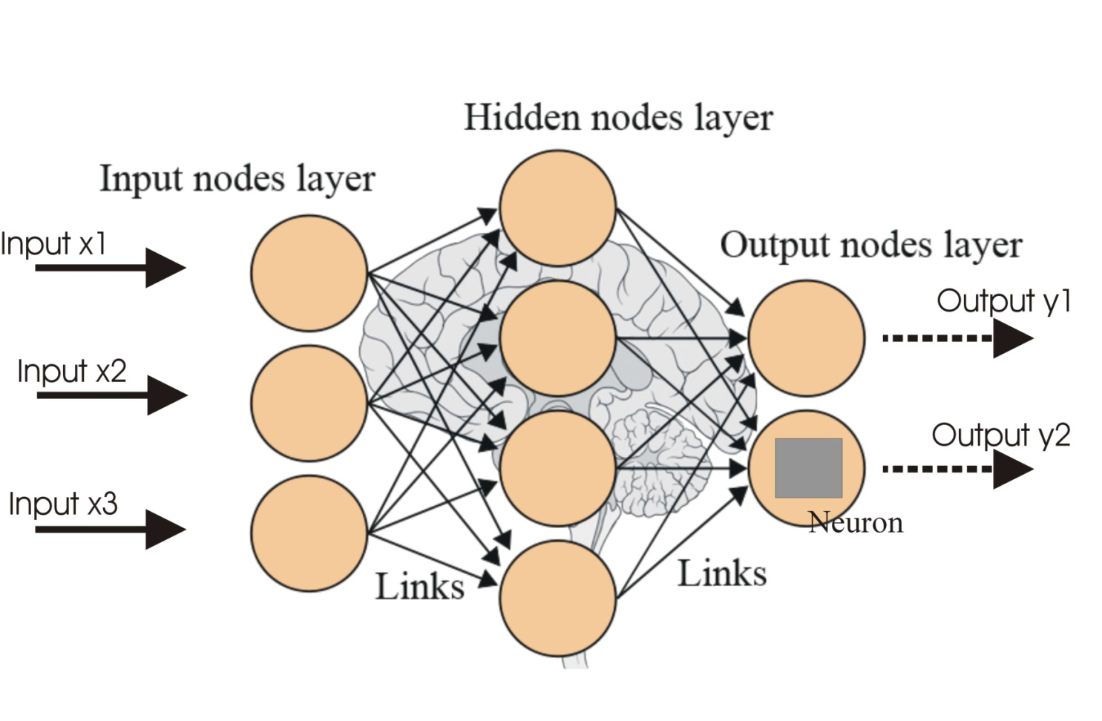
Artificial Neural Network
From experience: examples / training data
•Strength of connection between the neurons is stored as a weight-value for the specific connection.
•Learning the solution to a problem = changing the connection weights

Slide 11
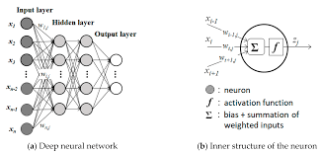

Slide 12
Types of Neural Networks
Depending upon the various attributes, these below are the following categories of Neural Network:
Learning methods:
Supervised
Unsupervised
Reinforcement
Connection Type:
Static (feed forward)
Dynamic (feedback)
Topology:
Single-layer
Multi-layer
Recurrent

Slide 13
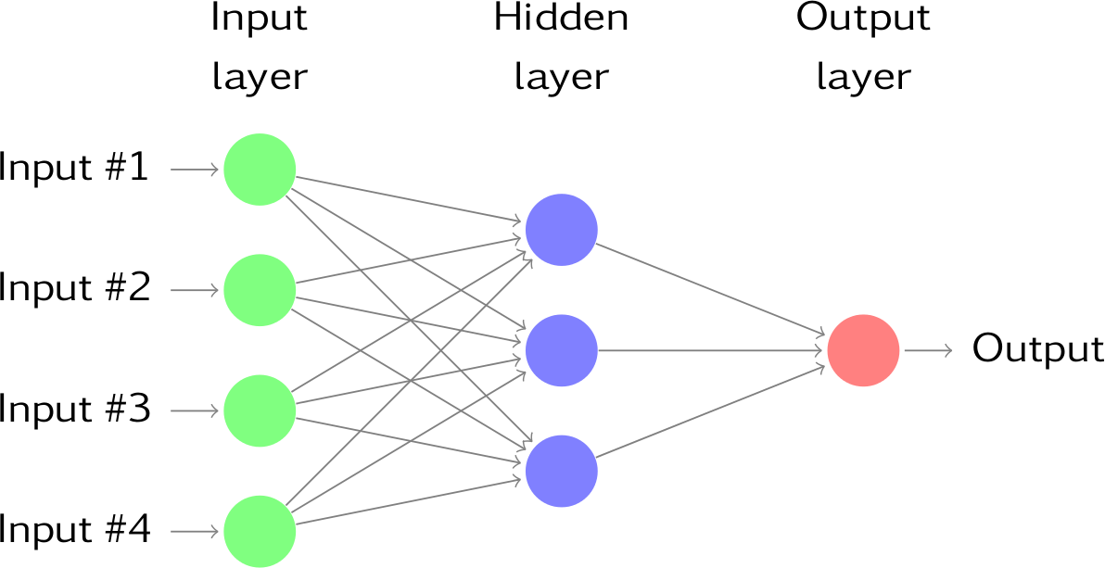





Single layer neural network

Slide 14
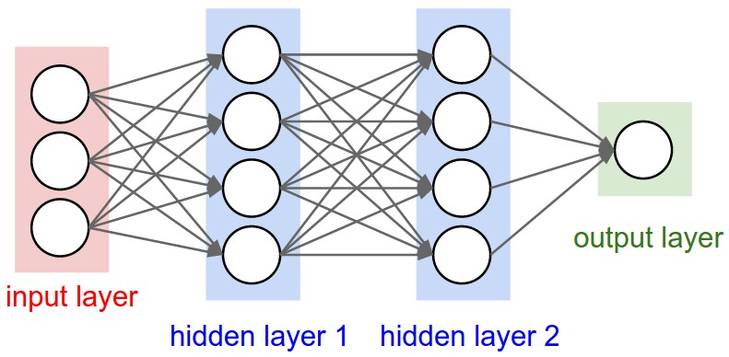
Multi layer neural network

Slide 15
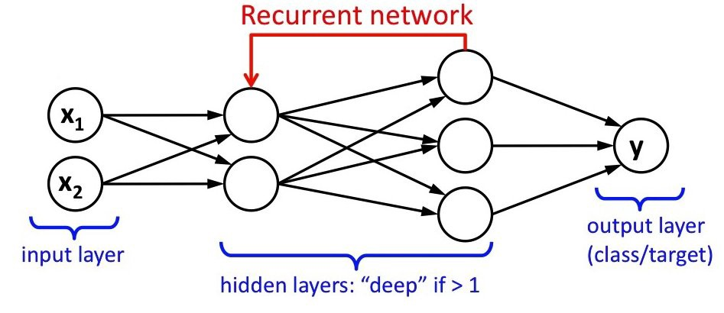
Recurrent neural network

Slide 16
Artificial neural network
In fact, the human brain is a highly complex structure viewed as a massive, highly interconnected network of simple processing elements called neurons.
Artificial neural networks (ANNs) or simply we refer it as neural network (NNs), which are simplified models (i.e. imitations) of the biological nervous system, and obviously, therefore, have been motivated by the kind of computing performed by the human brain.
The behavior of a biolgical neural network can be captured by a simple model called artificial neural network.

Slide 17
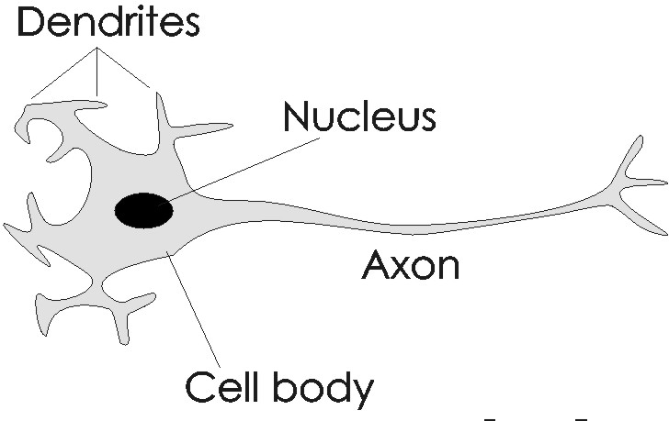


Analogy between BNN and ANN
x1
w1
x2
w2
w3
x3
wn
xn

Slide 18
Artificial neural network
We may note that a neuron is a part of an interconnected network of nervous system and serves the following.
Compute input signals
Transportation of signals (at a very high speed) Storage of information
Perception, automatic training and learning
We also can see the analogy between the biological neuron and artificial neuron. Truly, every component of the model (i.e. artificial neuron) bears a direct analogy to that of a biological neuron. It is this model which forms the basis of neural network (i.e. artificial neural network).

Slide 19

Artificial neural network
x1
w1
x2
w2
w3
x3
wn
xn
…..
input
weight
Summation unit
Threshold unit
output
Here, x₁, x₂, · · · , x_{n} are the n inputs to the artificial neuron.
w₁, w₂, · · · , w_{n} are weights attached to the input links.

Slide 20
Artificial neural network
Hence, the total input say I received by the soma of the artificial neuron is
Σ
I = w₁x₁ + w₂x₂ + · · · + w_{n}x_{n} =
n i =1
w_{i} x_{i}
To generate the final output y , the sum is passed to a filter φ
called transfer function, which releases the output.
That is, y = φ(I)
Ø(I)
x1
w1
x2
w2
I
y
w3
x3
wn
…..
xn
Summation unit
input
weight
Threshold unit
output

Slide 21
Advantages of ANN
ANNs exhibits mapping capabilities, that is, they can map input patterns to their associated output pattern.
The ANNs learn by examples. Thus, an ANN architecture can be trained with known example of a problem before they are tested for their inference capabilities on unknown instance of the problem. In other words, they can identify new objects previous untrained.
The ANNs posses the capability to generalize. This is the power to apply in application where exact mathematical model to problem are not possible.

Slide 22
Advantages of ANN
The ANNs are robust system and fault tolerant. They can therefore, recall full patterns from incomplete, partial or noisy patterns.
The ANNS can process information in parallel, at high speed and in a distributed manner. Thus a massively parallel distributed processing system made up of highly interconnected (artificial) neural computing elements having ability to learn and acquire knowledge is possible.

Slide 23
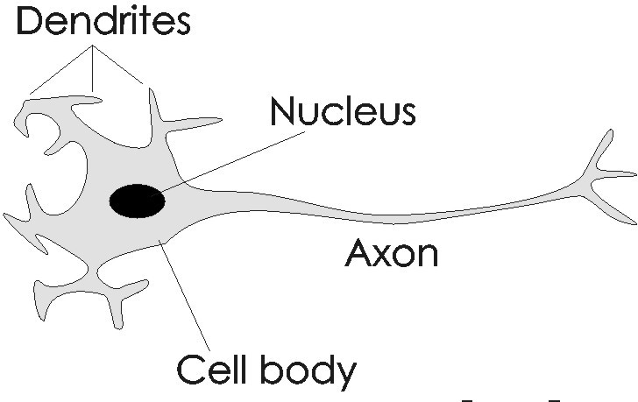
The AND problem and its neural network
Alternatively, the AND problem can be thought as a perception problem where we have to receive four different patterns as input and perceive the results as 0 or 1.
00
10
01
11
0
1
x₁
w1
Y
w2
x2

Slide 24
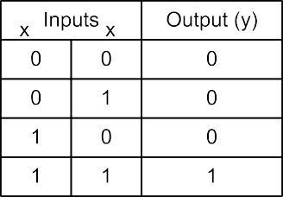
The AND problem and its neural network
A possible neuron specification to solve the AND problem is given in the following. In this solution, when the input is 11, the weight sum exceeds the threshold (θ = 0.9) leading to the output 1 else it gives the output 0.
1
2
1
2
Here, y = ^{Σ} w_{i} x_{i} − θ and w₁ = 0.5,w₂ = 0.5 and θ = 0.9
Soft Computing Applications
27.03.2018
24 / 27

Slide 25
References
Book:
Demuth, Howard B., et al. Neural network design. Martin Hagan, 2014.
Websites:
https://www.slideshare.net/databricks/introduction-to-neural-networks-122033415

Slide 26
THANK YOU

